Slide 1

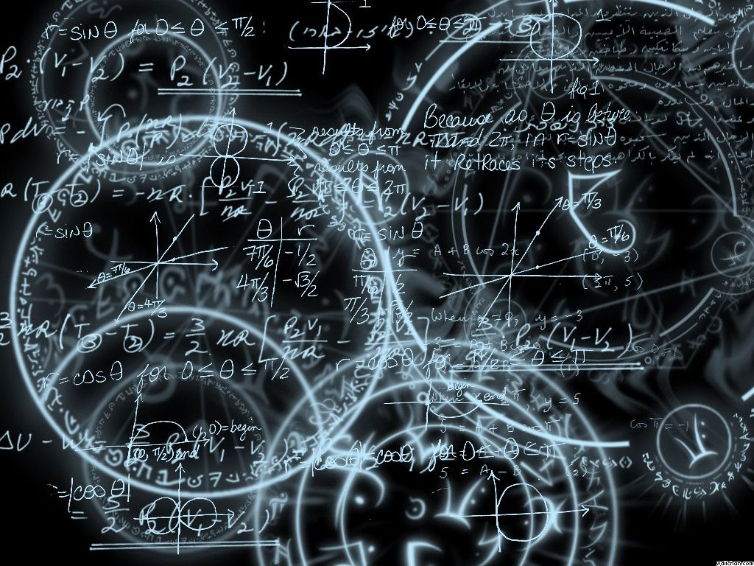
Azərbaycan Dövlət Neft və Sənaye Universiteti
Calculus
Single Variable

Slide 2
Differentiation:
The Chain Rule

Slide 3
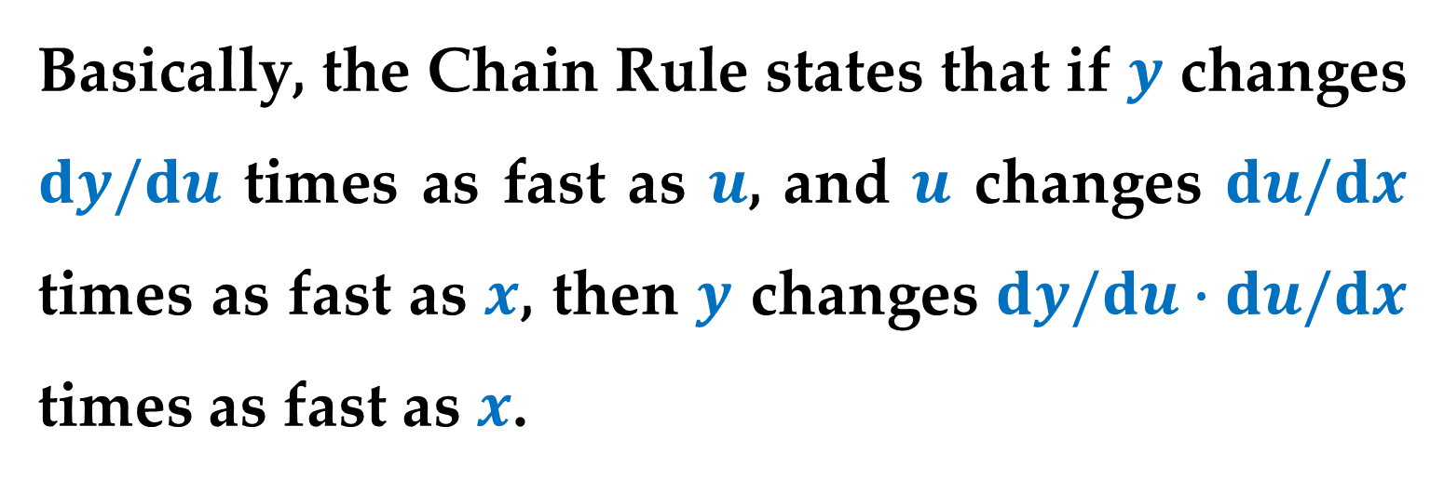
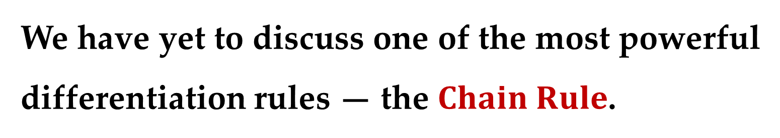
We have yet to discuss one of the most powerful differentiation rules — the $Chain Rule$.
This rule deals with composite functions and adds a surprising versatility to the rules discussed in the two previous lectures.
Basically, the Chain Rule states that if $y$ changes $dy/du$ times as fast as $u$, and $u$ changes $du/dx$ times as fast as $x$, then $y$ changes $dy/du∙du/dx$ times as fast as $x$.

Slide 4
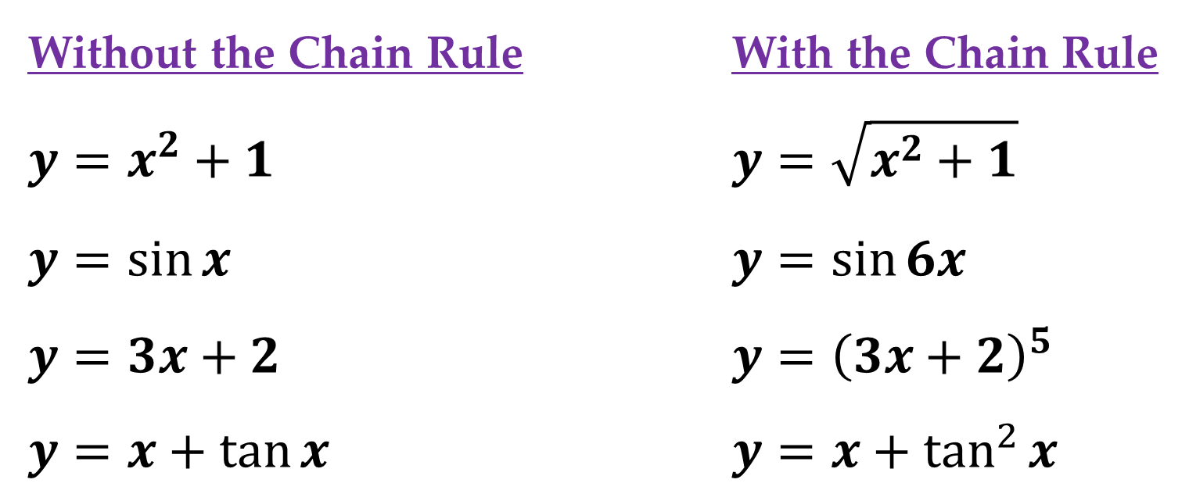
Without the Chain Rule With the Chain Rule
$y=x^{2}+1$ $y=\sqrt{x^{2}+1}$
$y=\sin{x}$ $y=\sin{6x}$
$y=3x+2$ $y={\left(3x+2\right)}^{5}$
$y=x+\tan{x}$ $y=x+\tan^{2}{x}$
Those on the left can be differentiated without the Chain Rule, and those on the right are best differentiated with the Chain Rule.

Slide 5
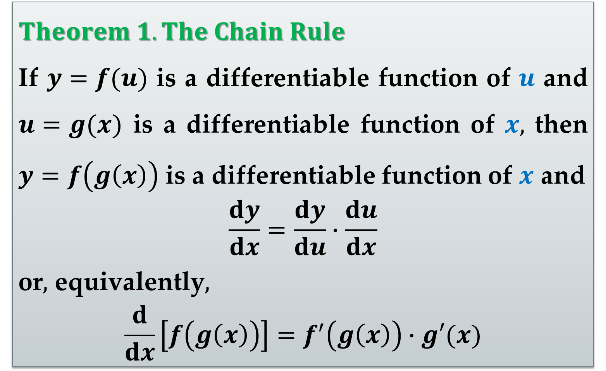
$Theorem 1. The Chain Rule$
If $y=f(u)$ is a differentiable function of $u$ and $u=g(x)$ is a differentiable function of $x,$ then $y=f\left(g\left(x\right)\right)$ is a differentiable function of $x$ and
$$\frac{dy}{dx}=\frac{dy}{du}∙\frac{du}{dx}$$
or$,$ equivalently$,$
$$\frac{d}{dx}\left[f\left(g\left(x\right)\right)\right]=f^{′}\left(g\left(x\right)\right)∙g′(x)$$

Slide 6
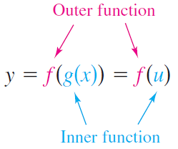
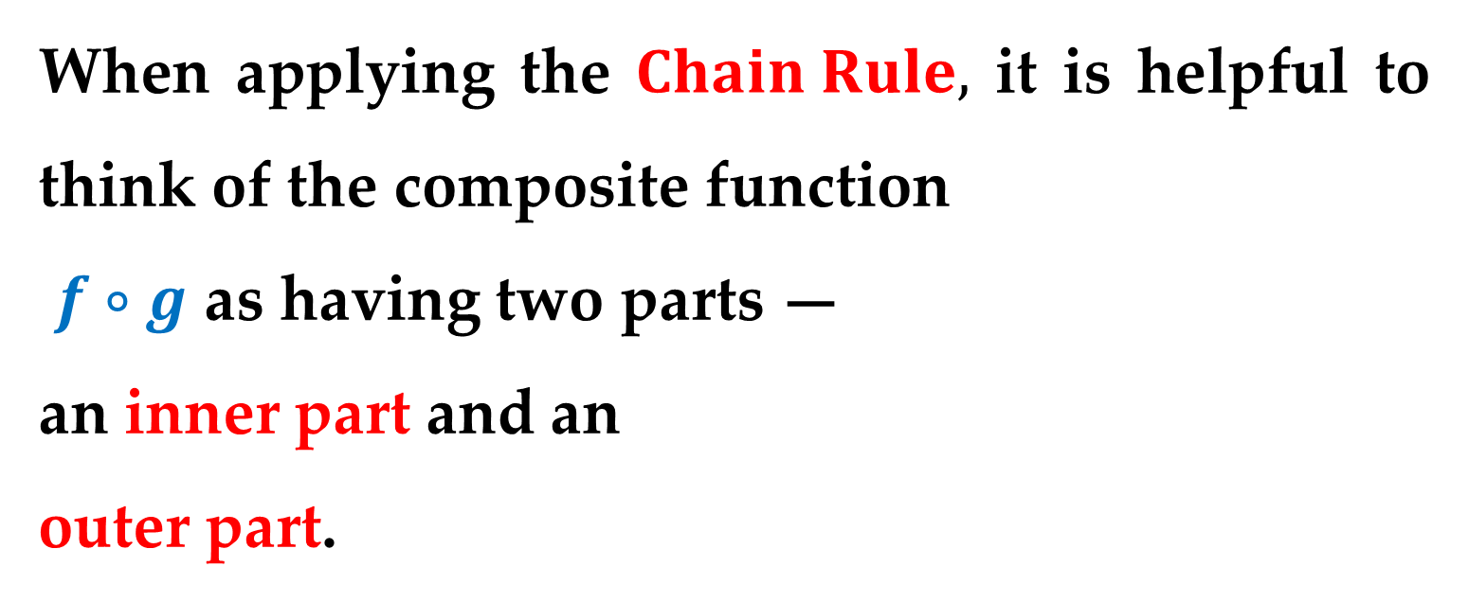
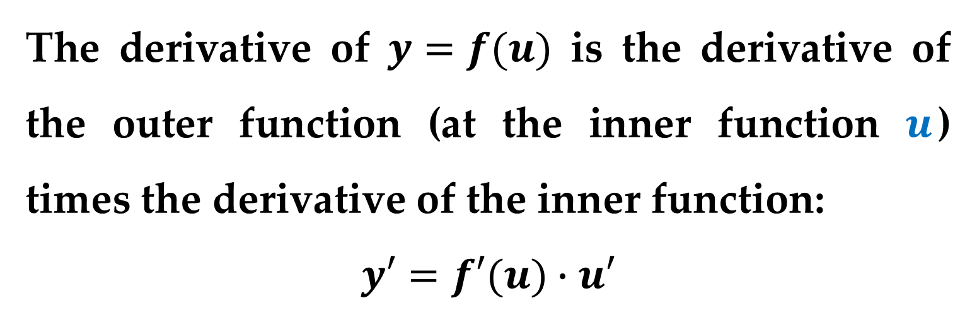
When applying the $Chain Rule,$ it is helpful to think of the composite function
$f∘g$ as having two parts —
an inner part and an
outer part.
The derivative of $y=f(u)$ is the derivative of the outer function (at the inner function $u$) times the derivative of the inner function:
$$y′=f′(u)∙u′$$

Slide 7
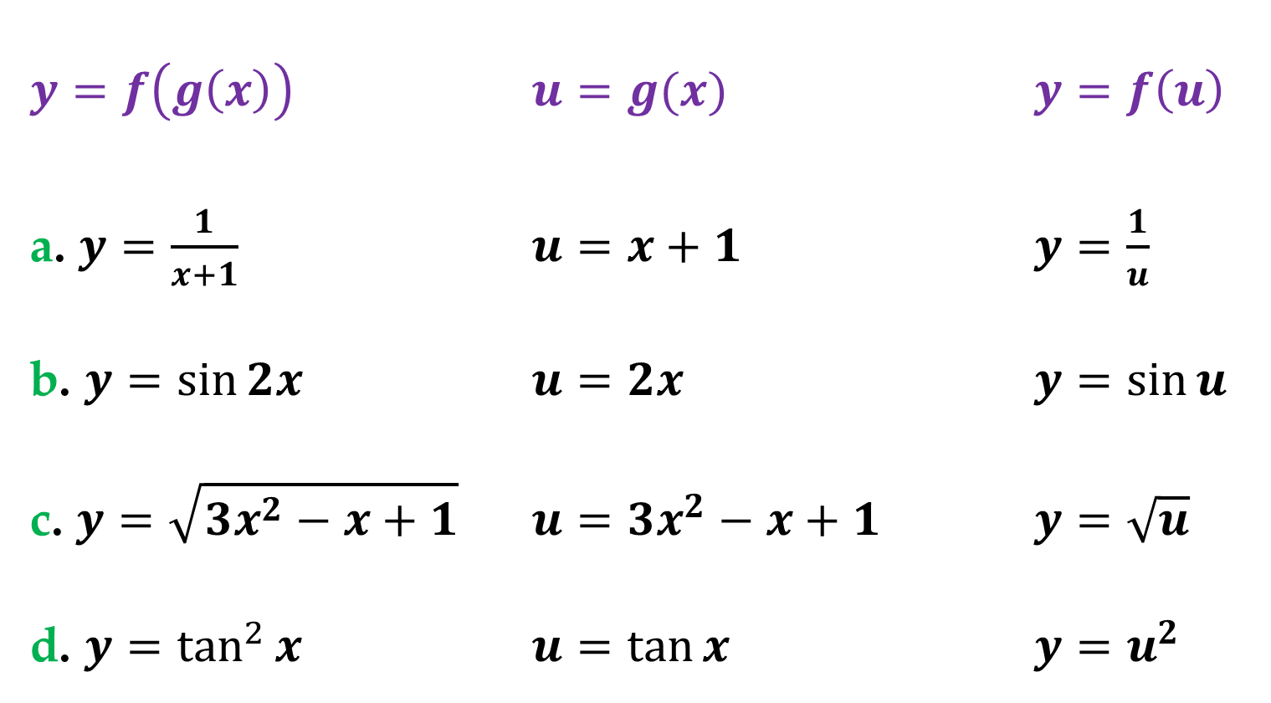
Example 1. Decomposition of a Composite Function
$y=f\left(g\left(x\right)\right)$ $u=g(x)$ $y=f\left(u\right)$
a. $y=\frac{1}{x+1}$ $u=x+1$ $y=\frac{1}{u}$
b. $y=\sin{2x}$ $u=2x$ $y=\sin{u}$
c. $y=\sqrt{3x^{2}−x+1}$ $u=3x^{2}−x+1$ $y=\sqrt{u}$
d. $y=\tan^{2}{x}$ $u=\tan{x}$ $y=u^{2}$

Slide 8
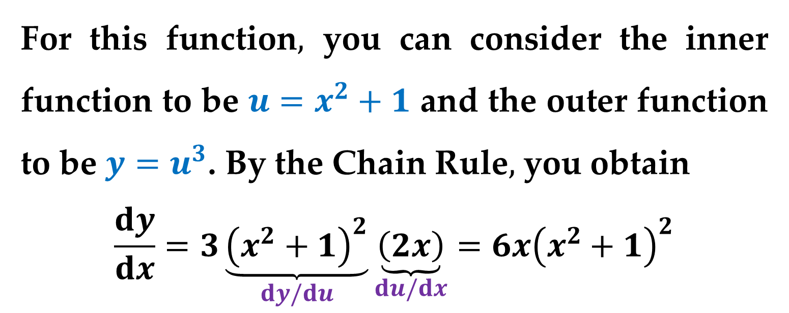
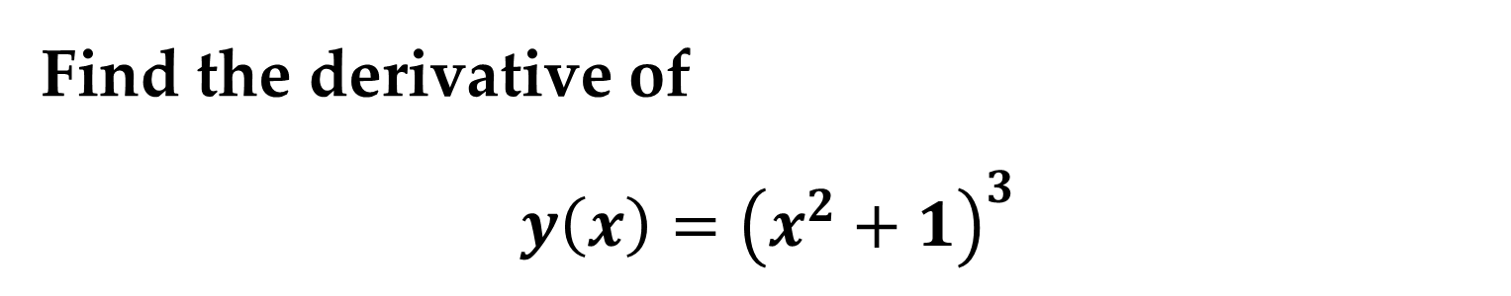
Example 2. Using the Chain Rule
Find the derivative of
$$y\left(x\right)={\left(x^{2}+1\right)}^{3}$$
Solution
For this function$,$ you can consider the inner function to be $u=x^{2}+1$ and the outer function to be $y=u^{3}$. By the Chain Rule$,$ you obtain
$$\frac{dy}{dx}=3\underset{dy/du}{\underbrace{{\left(x^{2}+1\right)}^{2}}}\underset{du/dx}{\underbrace{\left(2x\right)}}=6x{\left(x^{2}+1\right)}^{2}$$

Slide 9
The General Power Rule

Slide 10
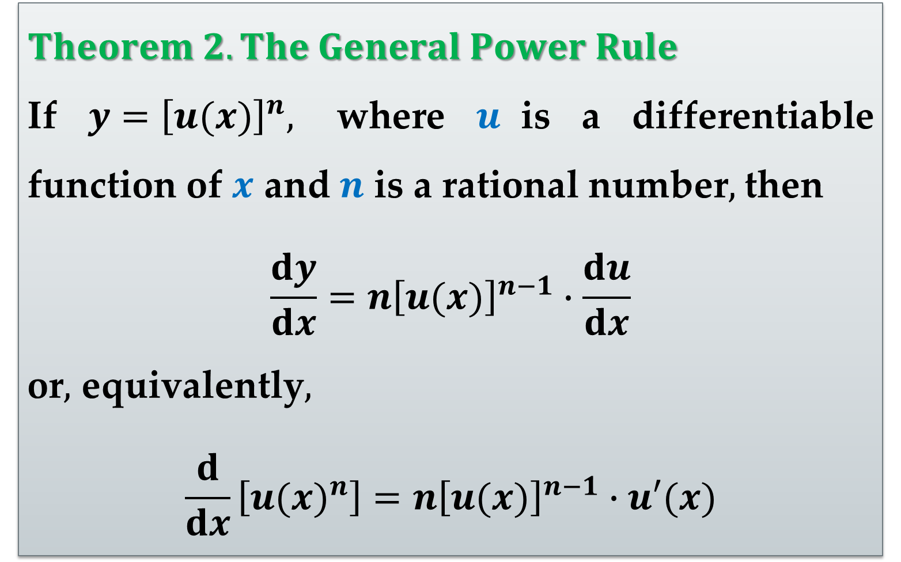
$Theorem 2. The General Power Rule$
If $y={\left[u(x)\right]}^{n},$ where $u$is a differentiable function of $x$ and $n$ is a rational number$,$ then
$$\frac{dy}{dx}=n{\left[u(x)\right]}^{n−1}∙\frac{du}{dx}$$
or$,$ equivalently$,$
$$\frac{d}{dx}\left[{u(x)}^{n}\right]=n{\left[u(x)\right]}^{n−1}∙u′(x)$$

Slide 11
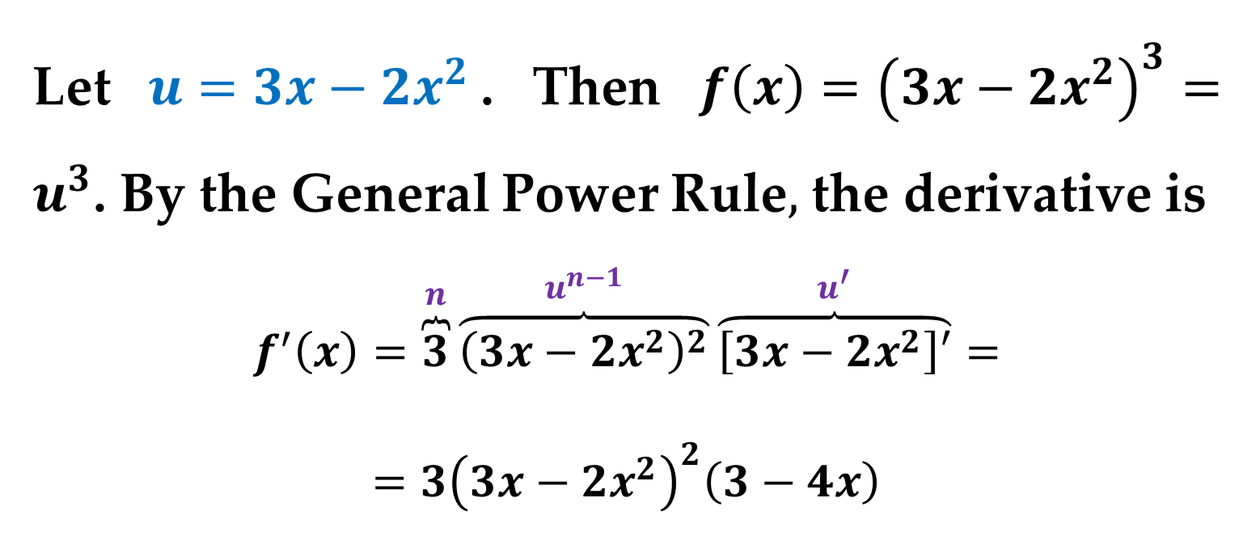
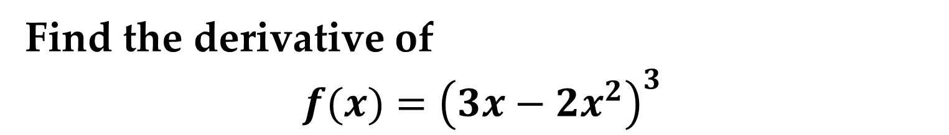
Example 3. Using the General Power Rule
Find the derivative of
$$f(x)={\left({3x−2x}^{2}\right)}^{3}$$
Solution
Let $u={3x−2x}^{2}$. Then $f\left(x\right)={\left({3x−2x}^{2}\right)}^{3}=u^{3}$. By the General Power Rule$,$ the derivative is
$$f^{′}\left(x\right)=\overset{n}{\overbrace{3}}\overset{u^{n−1}}{\overbrace{{\left(3x−2x^{2}\right)}^{2}}}\overset{u^{′}}{\overbrace{\left[3x−2x^{2}\right]′}}=$$
$$=3{\left(3x−2x^{2}\right)}^{2}\left(3−4x\right)$$

Slide 12
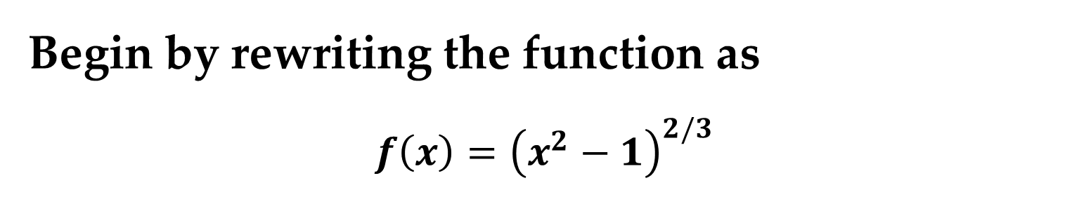
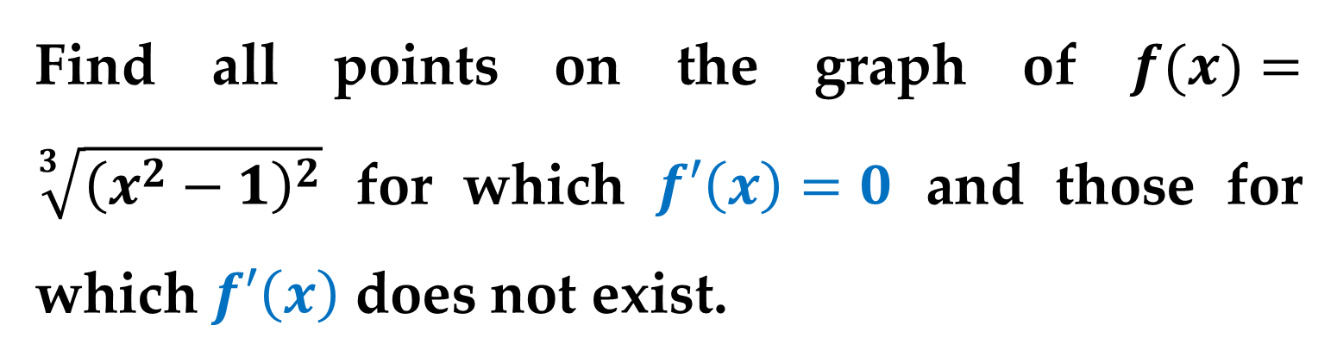
Example 4. Differentiating Functions Involving Radicals
Find all points on the graph of $f(x)=\sqrt[3]{{\left(x^{2}−1\right)}^{2}}$ for which $f′\left(x\right)=0$ and those for which $f′\left(x\right)$ does not exist.
Solution
Begin by rewriting the function as
$$f\left(x\right)={\left(x^{2}−1\right)}^{2/3}$$

Slide 13
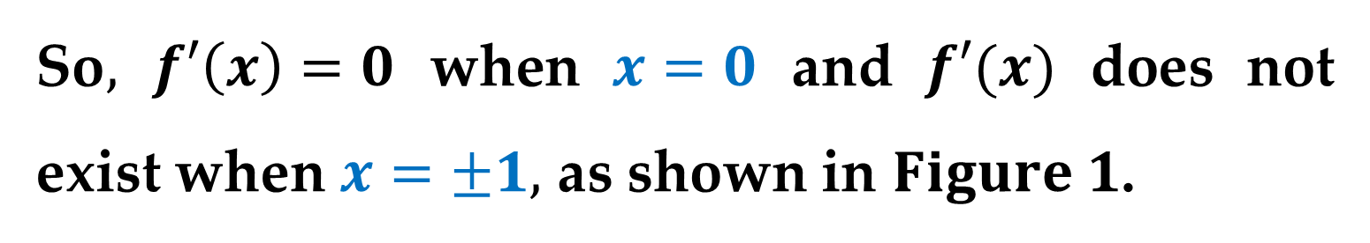
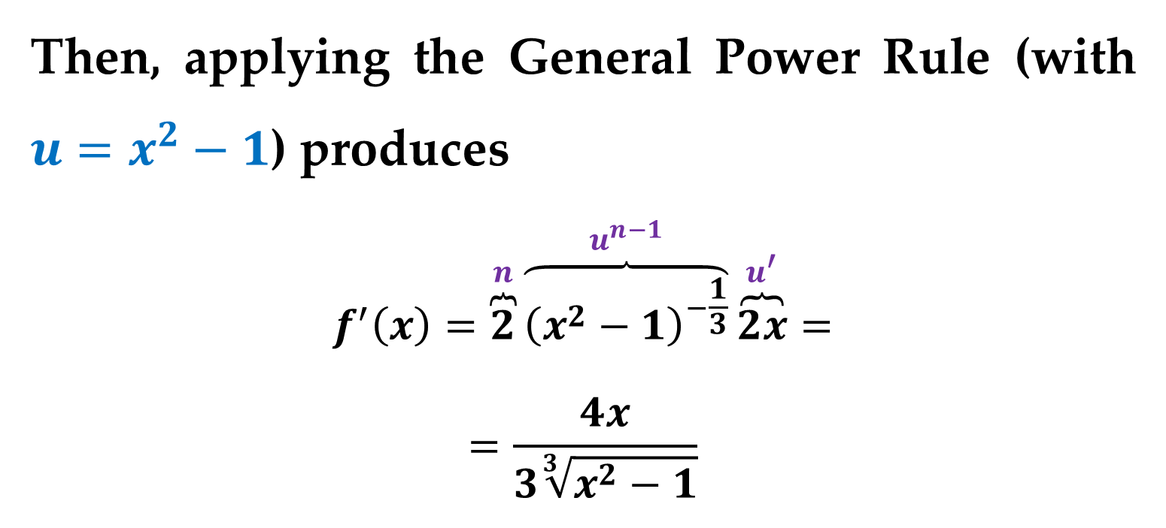
Solution (continued)
Then, applying the General Power Rule (with $u=x^{2}−1$) produces
$$f^{′}\left(x\right)=\overset{n}{\overbrace{2}}\overset{u^{n−1}}{\overbrace{{\left(x^{2}−1\right)}^{−\frac{1}{3}}}}\overset{u^{′}}{\overbrace{2x}}=$$
$$=\frac{4x}{3\sqrt[3]{x^{2}−1}}$$
So$,$ $f′\left(x\right)=0$ when $x=0$ and $f′(x)$ does not exist when $x=±1,$ as shown in $Figure 1$.

Slide 14
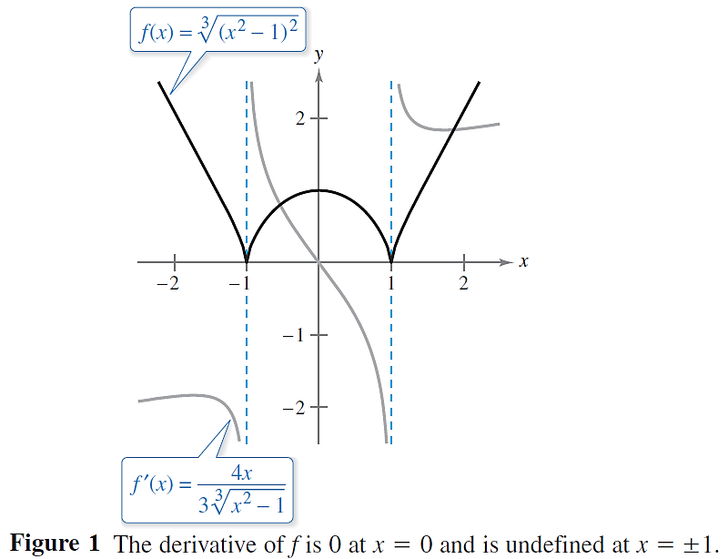
Solution (continued)

Slide 15
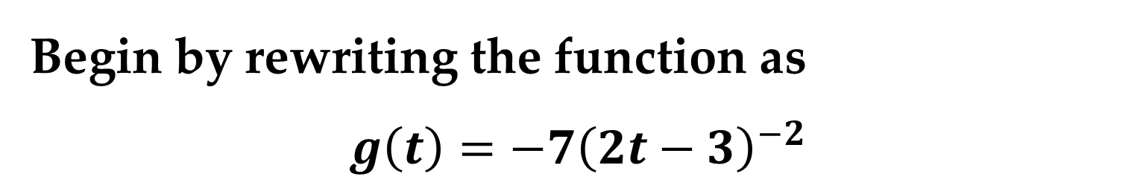
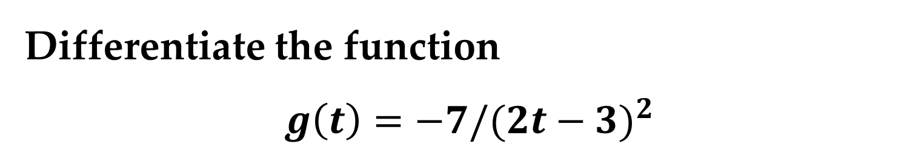
Example 5. Differentiating Quotients: Constant Numerators
Differentiate the function
$$g\left(t\right)=−7/{(2t−3)}^{2}$$
Solution
Begin by rewriting the function as
$$g\left(t\right)=−7{\left(2t−3\right)}^{−2}$$

Slide 16
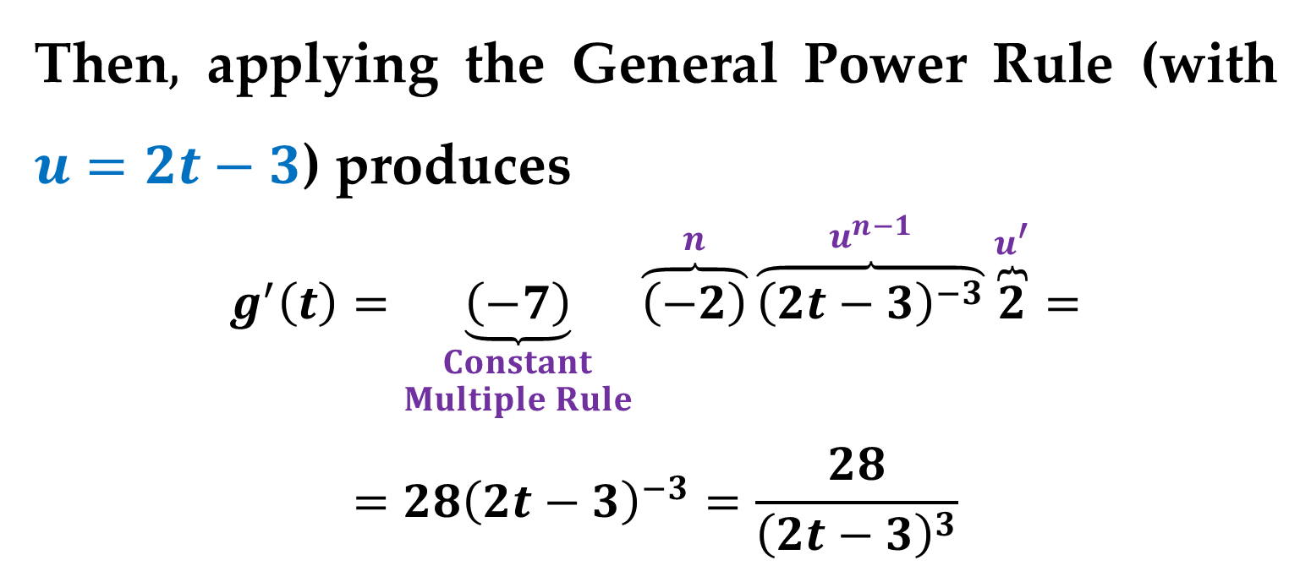
Solution (continued)
Then$,$ applying the General Power Rule (with $u=2t−3$) produces
$$g^{′}\left(t\right)=\underset{\begin{aligned}Constant \\ Multiple Rule\end{aligned}}{\underbrace{\left(−7\right)}}\overset{n}{\overbrace{\left(−2\right)}}\overset{u^{n−1}}{\overbrace{{\left(2t−3\right)}^{−3}}}\overset{u^{′}}{\overbrace{2}}=$$
$$=28{\left(2t−3\right)}^{−3}=\frac{28}{{\left(2t−3\right)}^{3}}$$

Slide 17
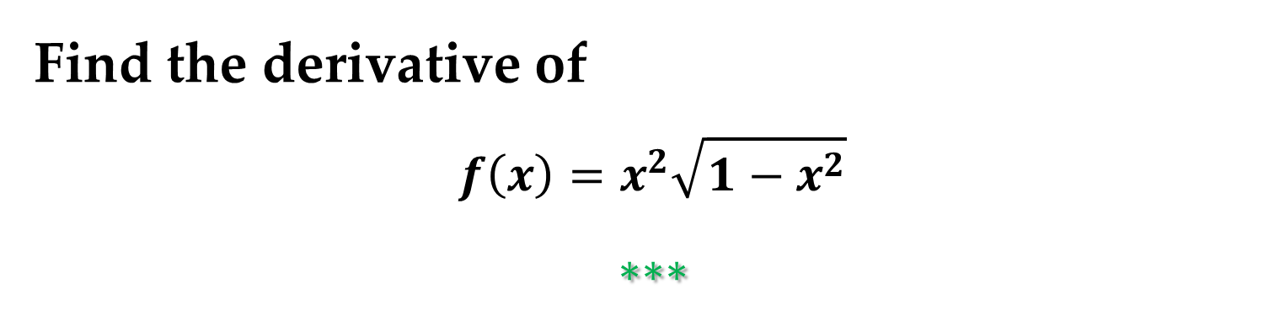
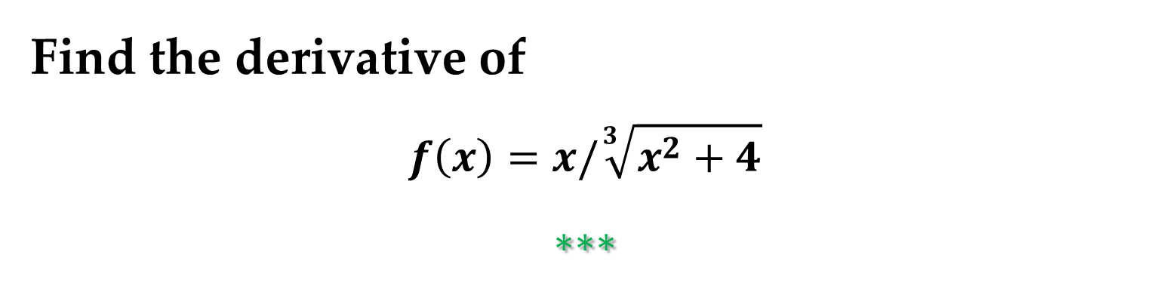
Example 6. Simplifying by Factoring Out the
Least Powers
Find the derivative of
$$f\left(x\right)=x^{2}\sqrt{1−x^{2}}$$
$$∗∗∗$$
Example 7. Simplifying the Derivative of a
Quotient
Find the derivative of
$$f\left(x\right)=x/\sqrt[3]{x^{2}+4}$$
$$∗∗∗$$

Slide 18

Example 8. Simplifying the Derivative of a Power
Find the derivative of
$$y\left(x\right)={ [(3x−1)/(x^{2}+3)]}^{2}$$
$$∗∗∗$$

Slide 19
Trigonometric Functions and the Chain Rule

Slide 20
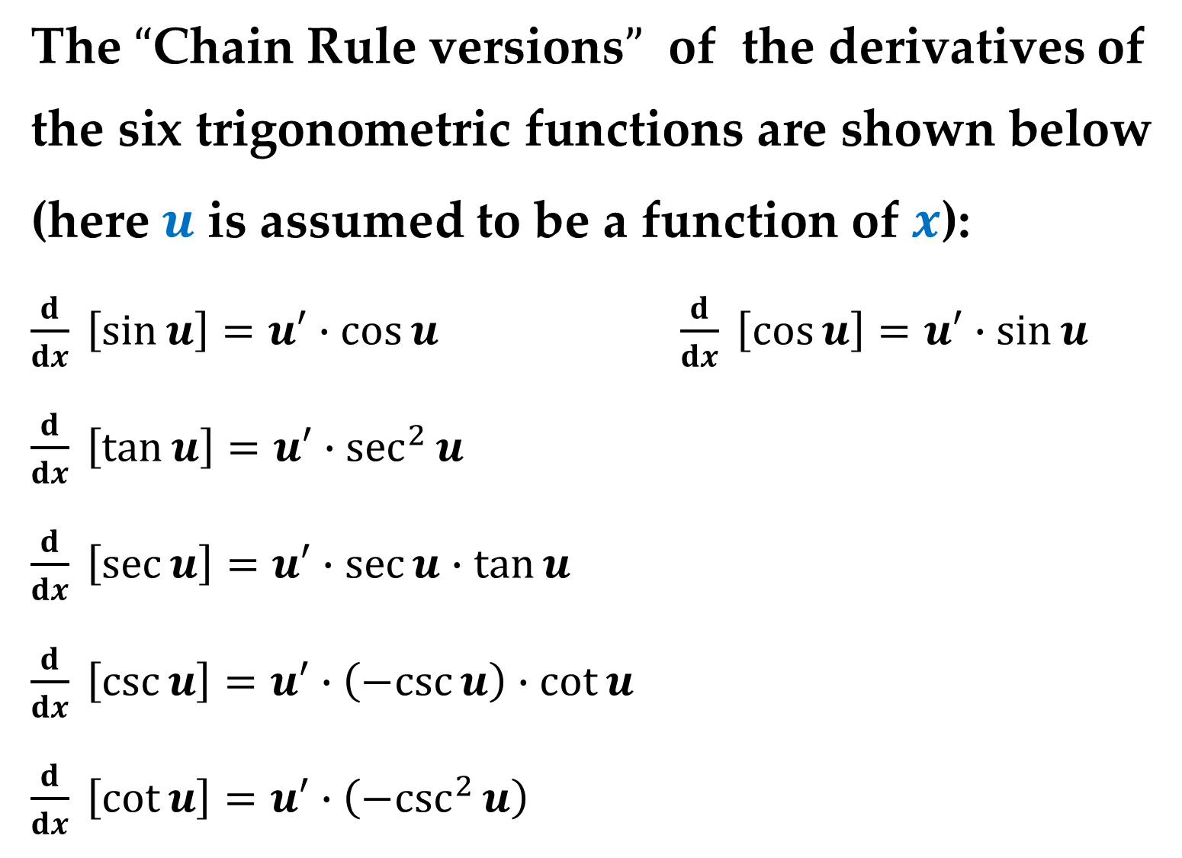
The $“$Chain Rule versions$”$ of the derivatives of
the six trigonometric functions are shown below (here $u$ is assumed to be a function of $x$):
$\frac{d}{dx} \left[\sin{u}\right]=u′∙\cos{u}$ $\frac{d}{dx} \left[\cos{u}\right]=u′∙\sin{u}$
$\frac{d}{dx} \left[\tan{u}\right]=u′∙\sec^{2}{u}$
$\frac{d}{dx} \left[\sec{u}\right]=u′∙\sec{u}∙\tan{u}$
$\frac{d}{dx} \left[\csc{u}\right]=u′∙\left(−csc{u}\right)∙\cot{u}$
$\frac{d}{dx} \left[\cot{u}\right]=u′∙\left({−csc}^{2}{u}\right)$

Slide 21
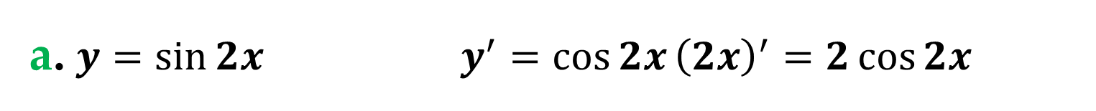
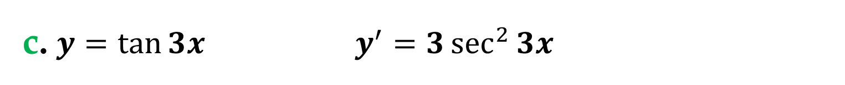
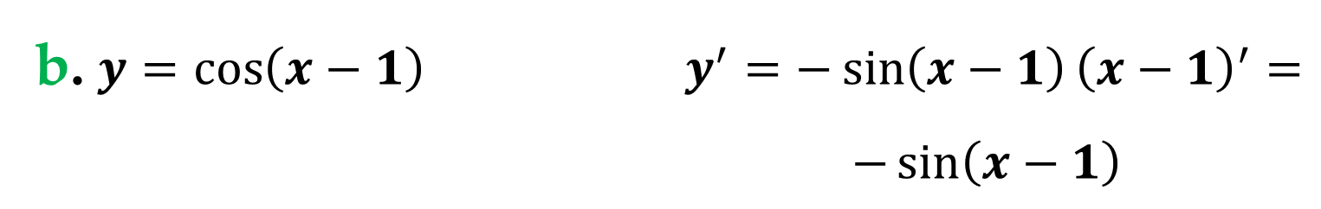
Example 9. The Chain Rule and Trigonometric Functions
a. $y=\sin{2x}$ $y^{′}=\cos{2x}{\left(2x\right)}^{′}=2\cos{2x}$
b. $y=\cos\left(x−1\right)$ $y^{′}=−\sin\left(x−1\right){\left(x−1\right)}^{′}=$
$$−\sin\left(x−1\right)$$
c. $y=\tan{3x}$ $y^{′}=3\sec^{2}{3x}$

Slide 22
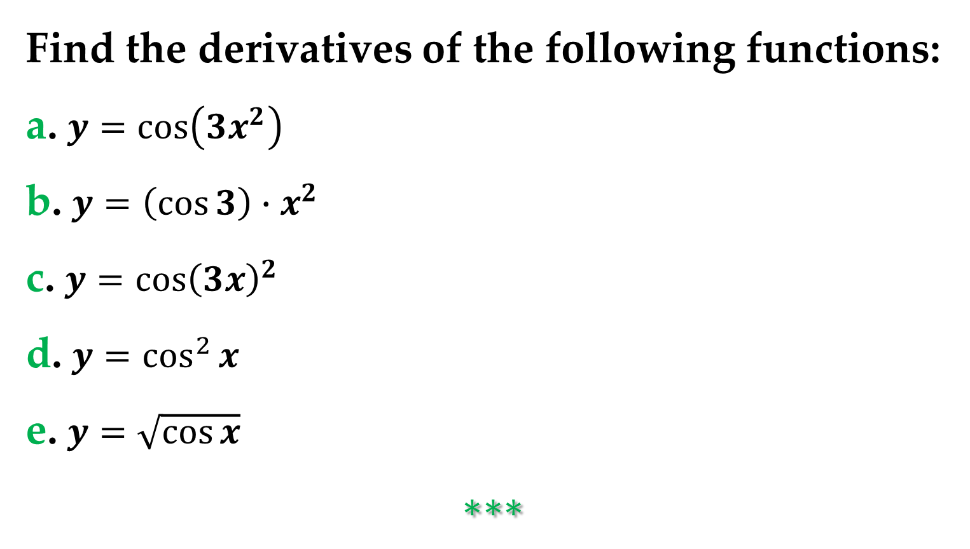
Example 10. Parentheses and Trigonometric Functions
Find the derivatives of the following functions:
a. $y=\cos\left(3x^{2}\right)$
b. $y=\left(\cos{3}\right)∙x^{2}$
c. $y=\cos{{\left(3x\right)}^{2}}$
d. $y=\cos^{2}{x}$
e. $y=\sqrt{\cos{x}}$
$$∗∗∗$$

Slide 23
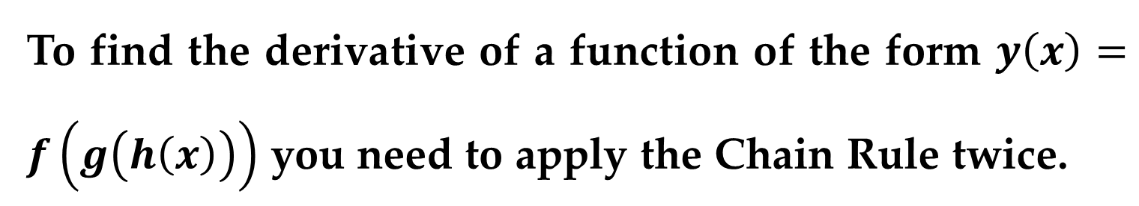
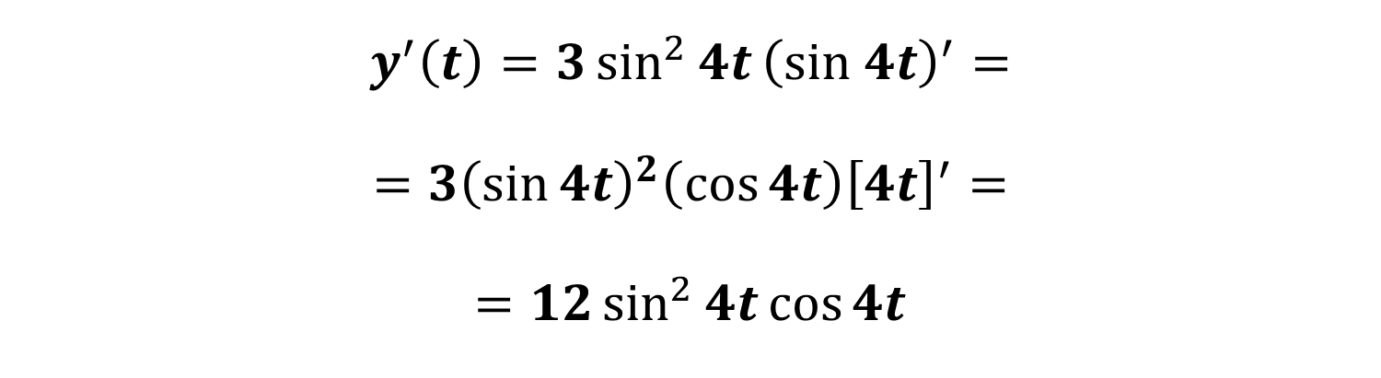
To find the derivative of a function of the form $y\left(x\right)=f\left(g\left(h\left(x\right)\right)\right)$ you need to apply the Chain Rule twice.
Example 11. Repeated Application of the Chain Rule
$$y\left(t\right)=\sin^{3}{4t}={\left(\sin{4t}\right)}^{3}$$
$$y^{′}\left(t\right)=3\sin^{2}{4t}{\left(sin 4t\right)}^{′}=$$
$$=3{\left(\sin{4t}\right)}^{2}\left(\cos{4t}\right){\left[4t\right]}^{′}=$$
$$=12\sin^{2}{4t}\cos{4t}$$

Slide 24
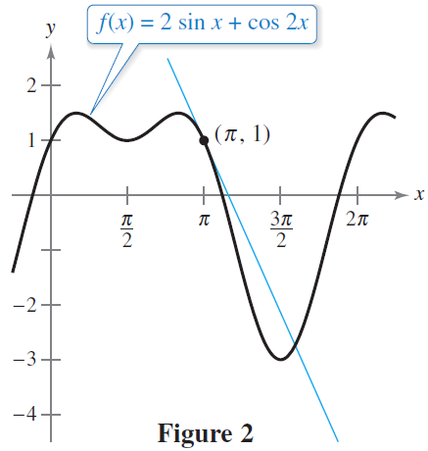
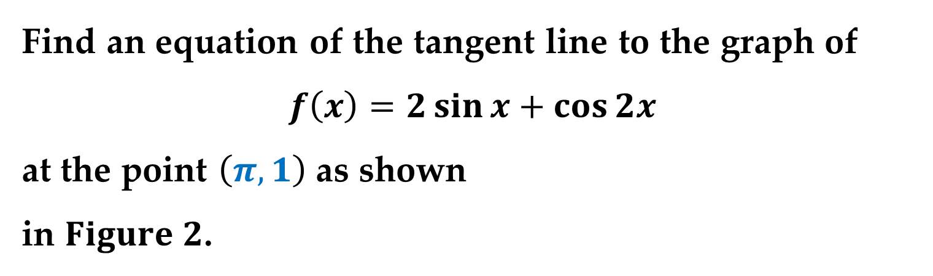
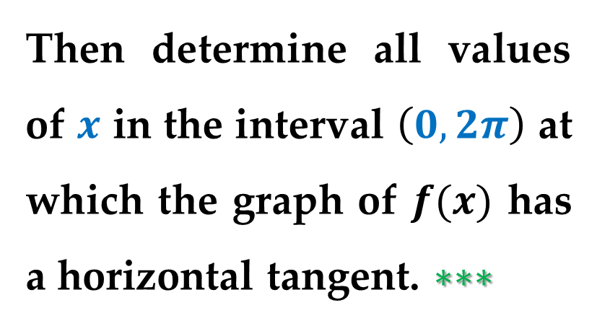
Example 12. Tangent Line of a Trigonometric
Function
Find an equation of the tangent line to the graph of
$$f\left(x\right)=2\sin{x}+\cos{2x}$$
at the point $\left(π,1\right)$ as shown
in $Figure 2$.
Then determine all values of $x$ in the interval $\left(0,2π\right)$ at which the graph of $f(x)$ has a horizontal tangent. $∗∗∗$

Slide 25
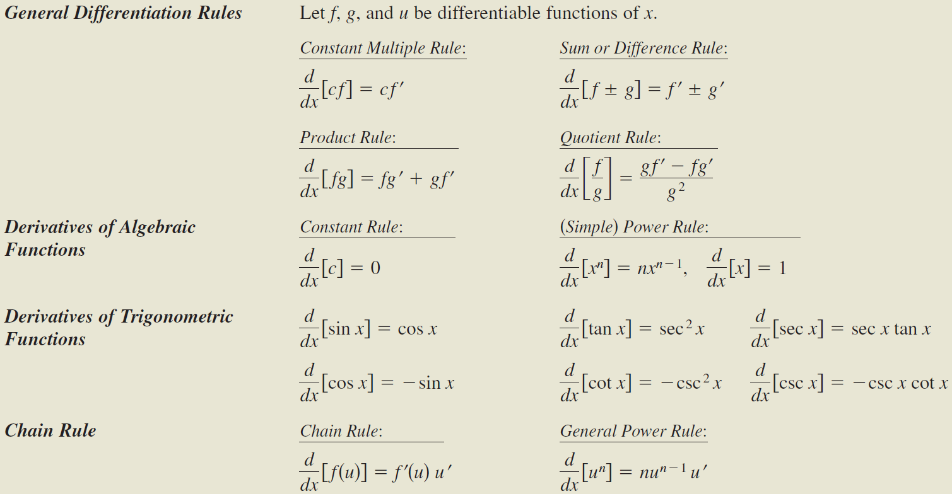
Summary of Differentiation Rules

Slide 26
Thank you for attention

